Slide 1

STAT305 Project (Step #1)
Project Proposal & Topic
Patrick Milks
100134354

Slide 2
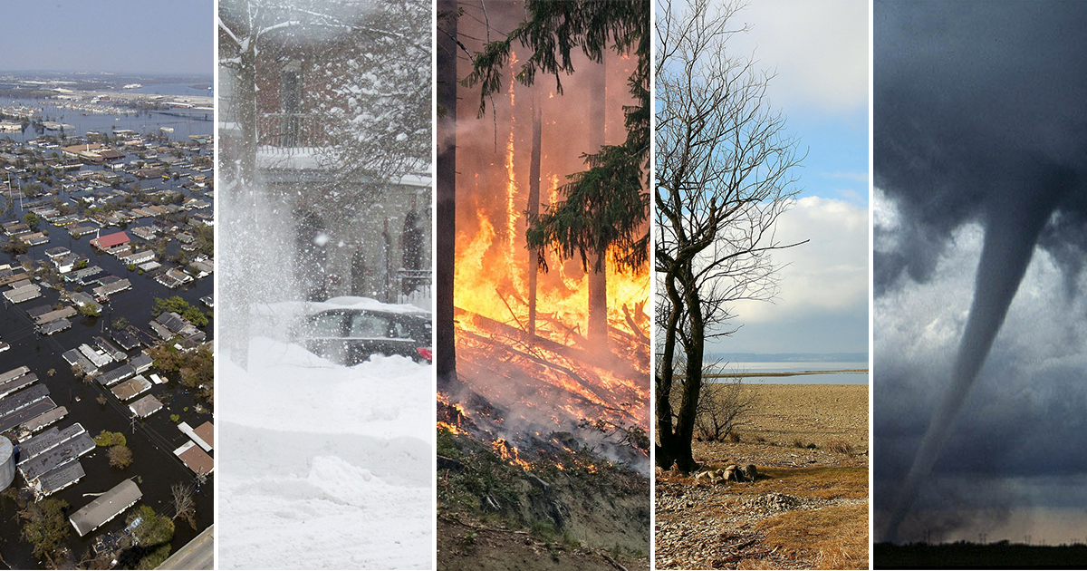
Topic:
Natural Disasters in north America & their changing impact

Slide 3
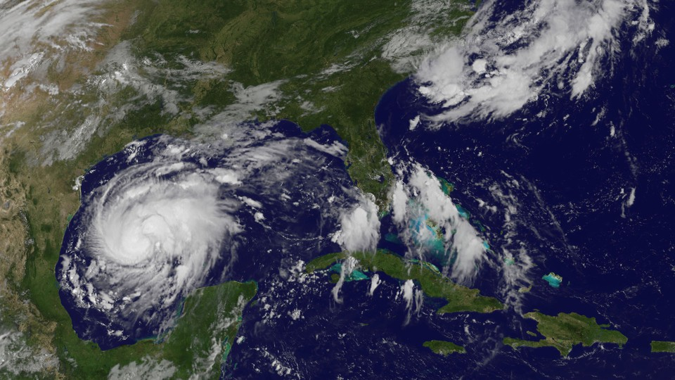
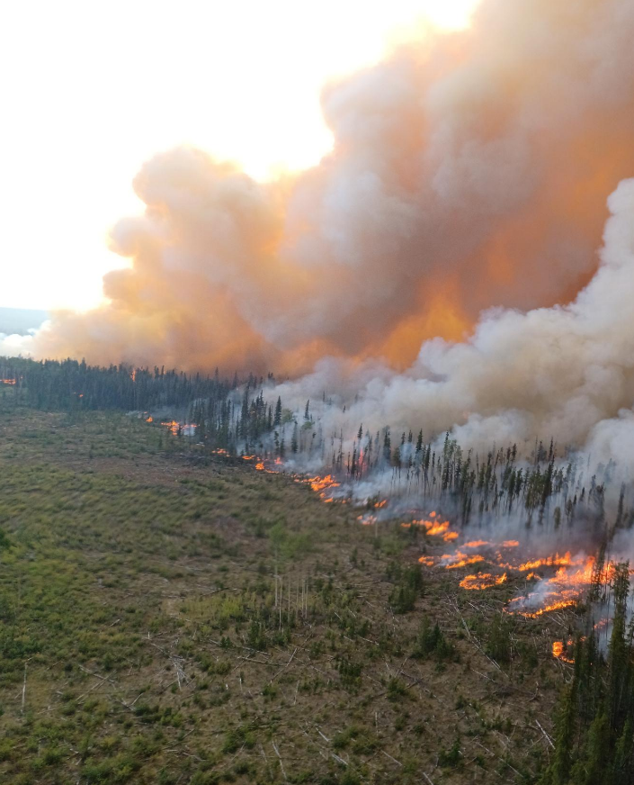
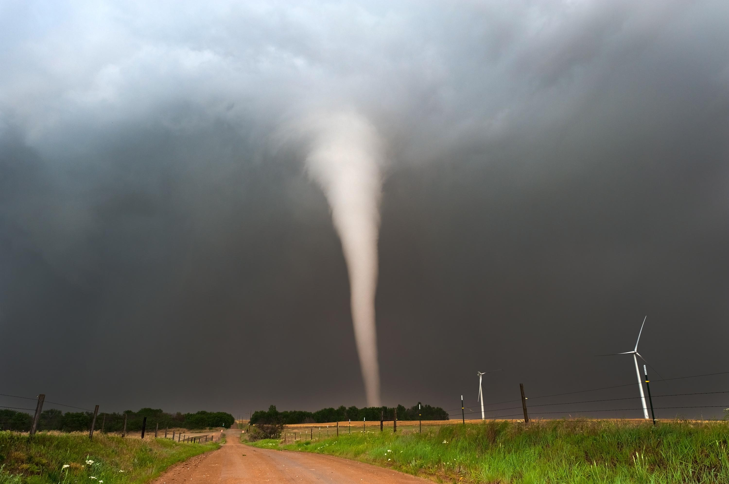
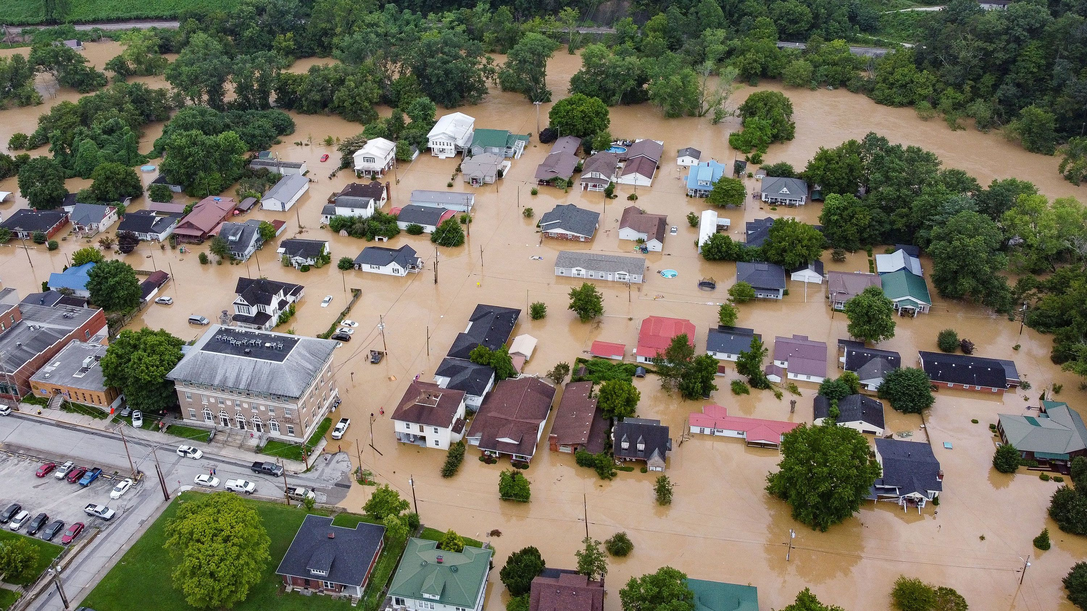
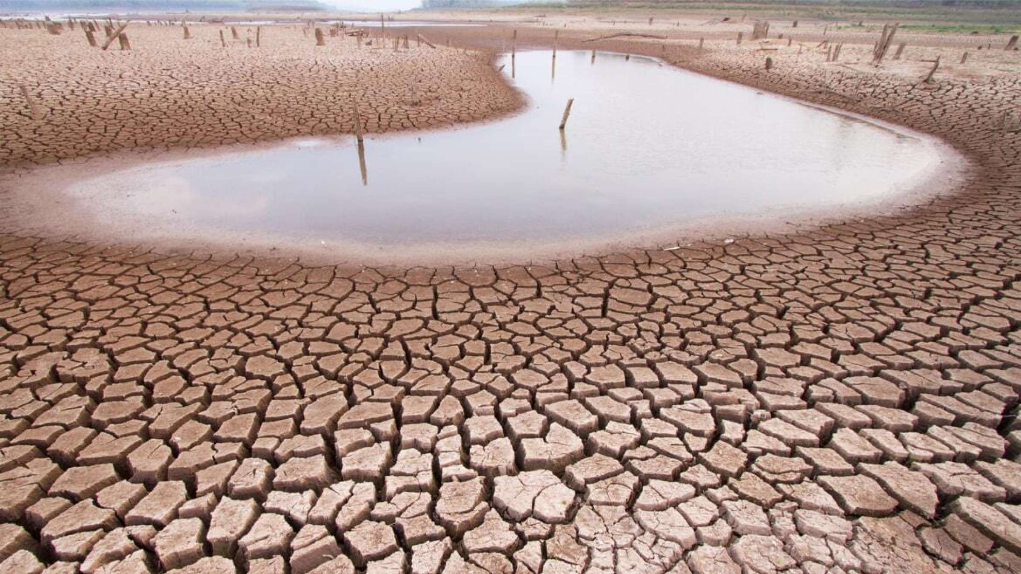
Subtopics:
Hurricanes with focus on the Gulf Coast
Wildfires in the U.S.
Tornadoes in the U.S.
Additional natural disasters possibly…

Slide 4
Personal Interest:
I chose this topic because as this wildfire season came to a close, I was curious if my intuition of wildfires become more severe year over year was true, both locally and continentally.
Also, I used to live in area that was frequently hit by hurricanes and began noticing that hurricane seasons now seem to include multiple large storms yearly comparative to the average of one medium to large storm I had come to expect.
I wanted to see if there were statistical trends for those and other natural disasters in North America and hypothesize as to the reasoning for these trends.

Slide 5
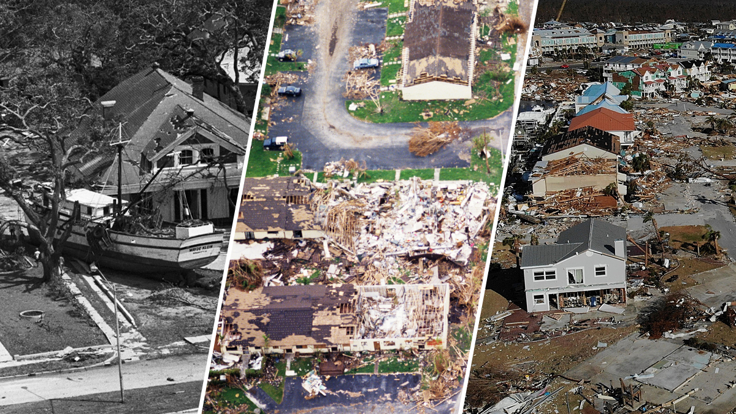
Research questions:
Have natural disasters become more, less or equally prevalent with time?
How impactful are natural disasters? What are the associated human and financial cost?
Among the studied natural disasters, which have been the most damaging?
How might the discovered trends be explained? Is climate change driving them? Have improved safety measures and funding led to reduced casualty and injury?

Slide 6
Data sources:
My analysis is derived of databases from:
FPA FOD (Fire Program Analysis Fire-Occurrence Database)
NIFC (National Interagency Fire Center)
NOAA’s NHC (National Oceanic & Atmospheric Administration’s National Hurricane Center) – HURDAT2
NOAA’s Storm Prediction Center(National Oceanic & Atmospheric Administration)
As the project scope changes, I’ll likely introduce other data sources.

Slide 7
Data Variables:
Analysis will change for each natural disaster as their measurements are different, but for each these variables will be included:
Fatalities
Injuries
Economic damage ($)
Occurrence date
Affected region

Slide 8
Statistical tools & measurements:
Step #2: will include simple statistical measurement (central tendency, variation, standard deviation) and visualizations summarizing data.
Step #3: will use correlation and regression analysis to measure bivariate relationships (ex. wildfire occurrence rate & continental average temperatures). Hypothesis testing will determine whether my statistical conclusions can be extrapolated for whole or future populations.
Step #4: will perform classification using logistical regression, again using t-tests for hypothesis testing.

Slide 9

STAT305 – Project Step #2
Descriptive Statistics
Patrick Milks
100134354

Slide 10
Introduction
In Step #2, with a focus on hurricanes, search to visualize broad categorical data describing hurricane tendencies over time
Graphical representations include:
- Yearly storm count
- Historical average peak wind speed
- Storm intensity levels over time
Technical and statistical methodology for each measurement will accompany for fuller understanding
Followed by a general conclusion:
Are there sizeable trends?
What environmental assumptions can be made?
What are the next steps to confirm or deny suspicions?

Slide 11
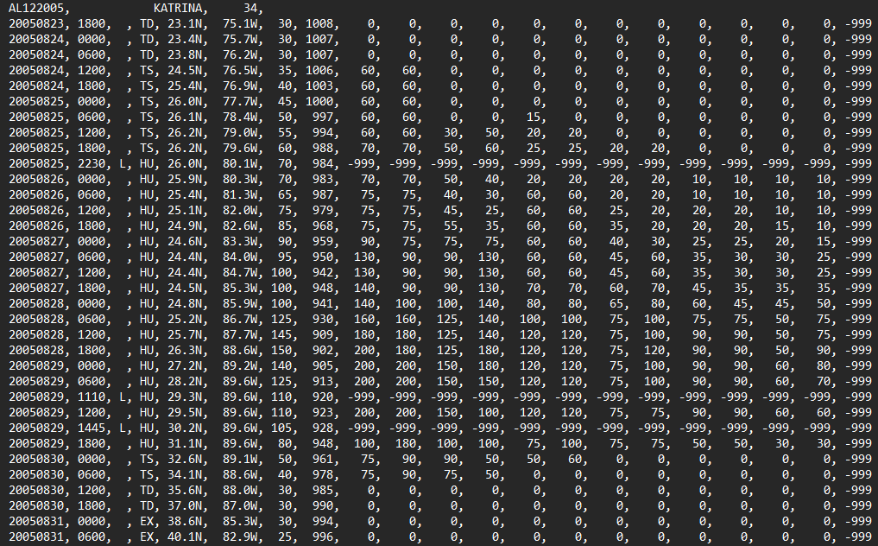
Preface
The HURDAT2 is a .csv (comma separated value) database provided by the National Hurricane Center (American Governmental Agency) tracks Atlantic hurricanes since 1851.
For the purposes of this project, a sample size of the last 100 years was chosen (1923-2023)
I parsed the data into separate hurricanes organized as Python classes with data attributes and a list of readings also transformed into more readable classes.
Example HURDAT2 entry of Hurricane Katrina:

Slide 12
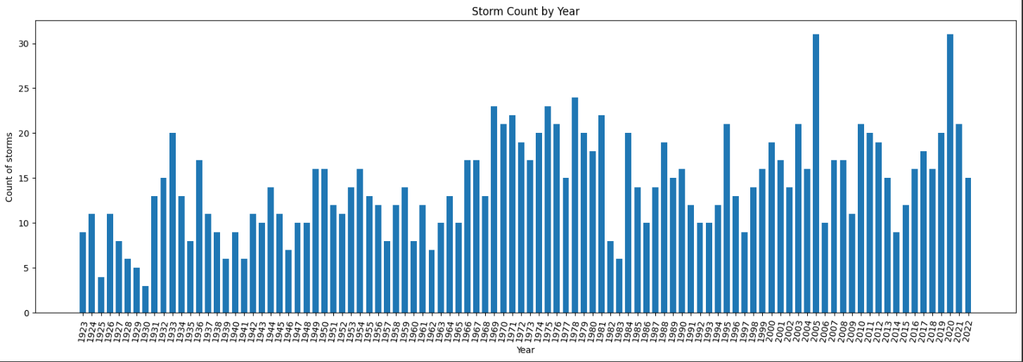
Storm count by Year
The easiest and broadest measure to try and determine hurricane trends.
Using the ‘year’ tag on each hurricane, the count of storms each year was summed and graphed from 1923-2023.

Slide 13
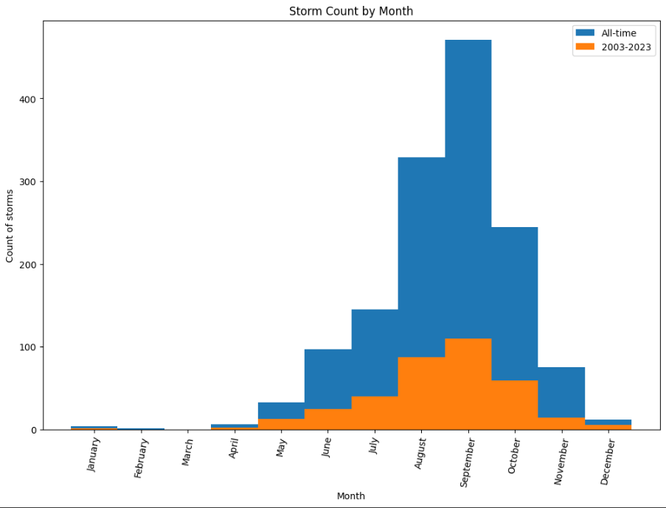
Storm count by month
Hurricanes are very seasonal as the depend on a mixture of warm and cold front over the bodies of water where they are born
Compare the recent distribution of storm births by month relative to its historical average can indicate if the environmental requirement for hurricanes are becoming or less present at different times during the year
Would changing global temperatures lead to a significant shift in hurricane season?

Slide 14
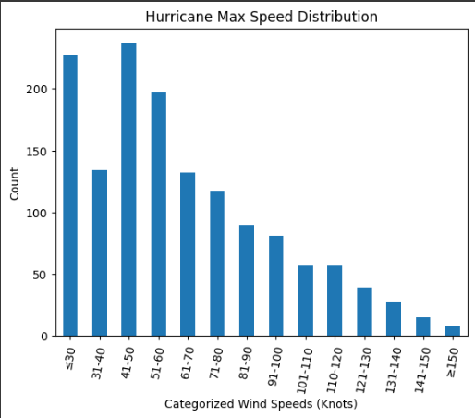
Historical Max wind speed distribution
A hurricane’s max wind speed be an indicator to how favorable the environment is for hurricane formation & growth
All tracked storms’ max wind speed are binned among various speeds measured in knots
Useful to determine the all-time distribution of storm max wind speeds
What speed is the most common?
How does recent data match this historical data?

Slide 15
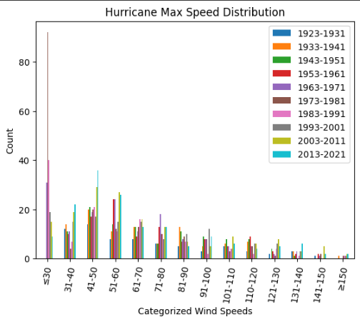
Hurricanes by max wind speed sorted by era
Storm max wind speeds sorted by speed in knots and era
Displays what storm is most frequent and infrequent by decade
See what eras are outliers among each other
What eras are most frequent among low, medium and high wind speeds?

Slide 16
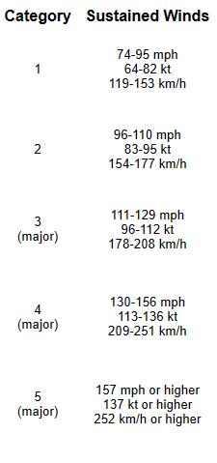
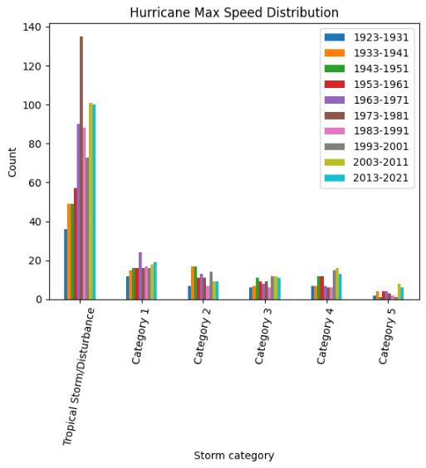
Hurricane category distribution by area
Hurricanes are typically organized into categories corresponding to how dangerous they are
These categories are measured by sustained wind speeds rather than max wind speed as used here but most storms are at their strongest near landfall making it an accurate measurement

Slide 17
Methodology
How was each visualization made?
STAT305 Step #2 - Google Collab Preview

Slide 18
Conclusion
Overall, many of the graphs do not provide decisive evident to lean hypothesizes in either direction. A majority of the visualizations are univariate counts of data that serve as a baseline to display distributions.
Measures over time are also inconclusive due to the slow changing nature of large-scale meteorological event and the magnitude of old data relative to the new.
Simple descriptive statistics rarely able to unveil clear trends in large systems as there are typically too many confounding variables affecting the result.
However, interesting trends that may be worth further investigating:
“Why Category 4 & 5 are as prevalent as they’ve ever been over the past 20 years?” or
“Why the 2 highest storm seasons, by a large margin, are within the past 20 years?”

Slide 19
STAT305 – Project Step #3
Descriptive Statistics
Patrick Milks
100134354

Slide 20
Step #3 Introduction
In Step #3, used exploratory analysis like multivariate measures to better understand:
- Conditions for formation of hurricanes
- Factors leading to more devastation storms
- Future trends of these natural disasters
Different statistical tools used include:
- Correlation
- Regression
Visualizations here:
Oceanic temperature readings relation to annual hurricane formation
Economic damages relating to seasonal peak storms factors

Slide 21
Understanding Hurricane Formation
“Hurricanes form over the ocean, often beginning as a tropical wave—a low pressure area that moves through the moisture-rich tropics, possibly enhancing shower and thunderstorm activity.” – NOAA
Factors for formation:
Pre-existing weather disturbance
Warm water (~26.5 C°) over a depth of 50m.
Thunderstorm activity
Low wind shear

Slide 22
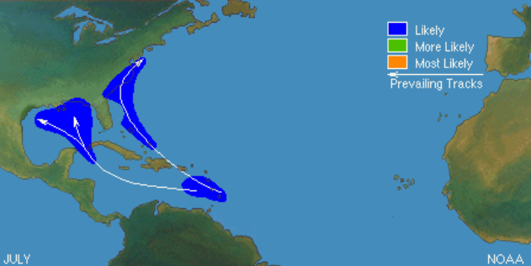
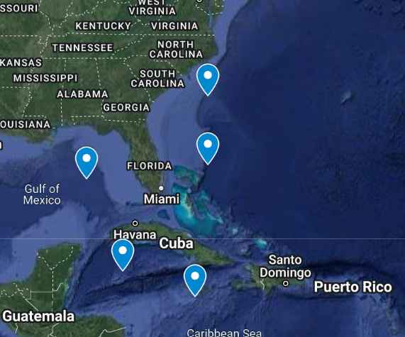
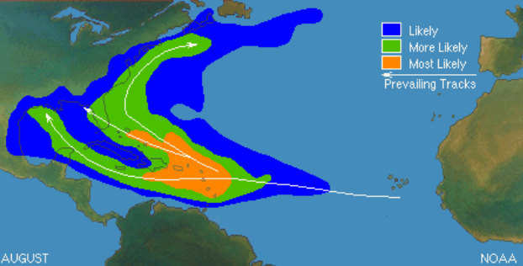
Historical Atlantic Storm paths
Historical Atlantic storm formation location and path in the months of July & August according to the Noaa
Five chosen Noaa gulf of Mexico and U.S. Coast oceanic temperature reading locations
West of South Carolina
West of Miami
Gulf of Mexico
Southeast Cuba
Dominican Republic

Slide 23
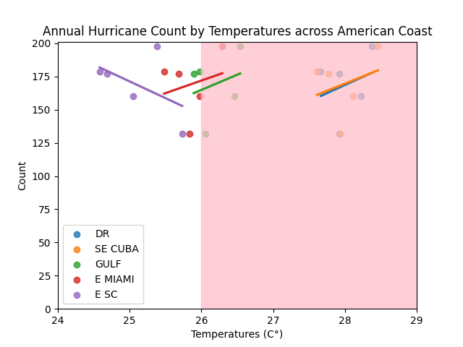
Hurricane Formation according to Oceanic temperatures
The shaded area indicates temperatures where hurricanes are most likely to start forming.
Each year’s hurricane count was associated with that year’s measured temperature per location
No statistically significant regression, however interesting to note ‘East South Carolina’ measures had the strongest negative correlation
Correlations became positive once the 26 C° mark was crossed
Regressions:
('DR’, 0.27648286447793424)
('SE CUBA', 0.28699652583287316)
('GULF', 0.2727980788565393)
('E MIAMI', 0.23418100519895257)
('E SC’, -0.48822848105381217)

Slide 24
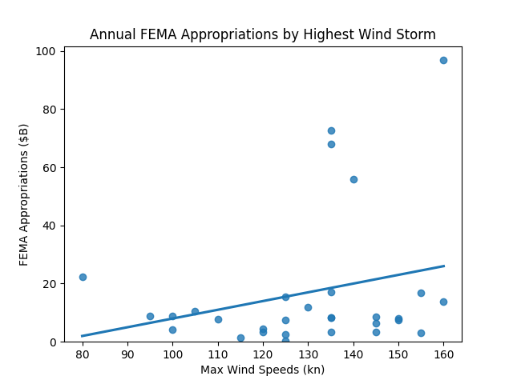
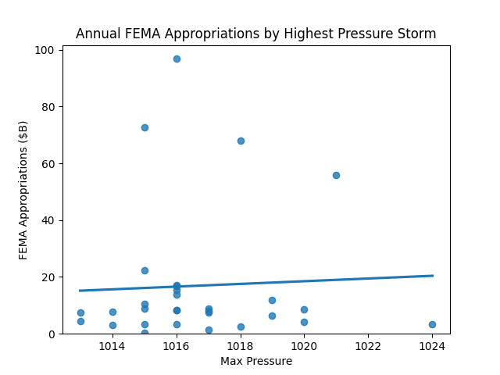
Economic damage by yearly storms
Highest maximum wind speed
Highest maximum pressure
KATRINA (2005)
IDA (2021)
Regressions:
[‘Max Wind’: 0.255785715958885]
[‘Max Pressure’: 0.048774304721655656]

Slide 25
Economic damage by yearly storms
Neither regression is significant, particularly the maximum pressure.
It is interesting to note the outliers including hurricanes Katrina & Ida and their driving effect on regression analysis.
Would the regression be stronger or weaker without them?
There seems to be a rough base level of yearly damage, regardless of storm intensity (~20$ billion).
Is measuring damages according to the largest seasonal storm the best manner of measurement? Should it be measured according to another factor like the number of storms?

Slide 26
Methodology
How was each visualization made?
STAT305 Step #3 - Google Collab Preview

Slide 27
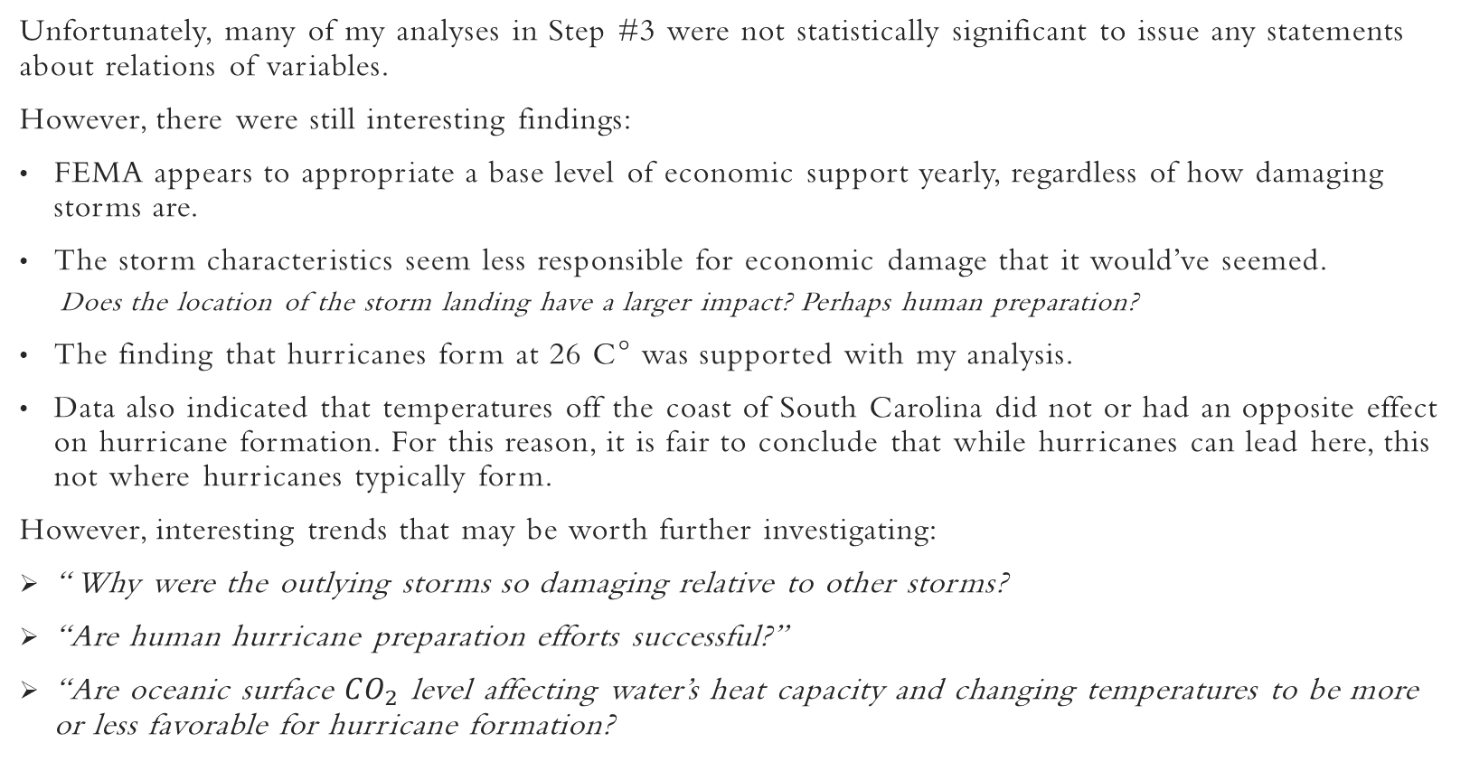
Conclusion
Unfortunately, many of my analyses in Step #3 were not statistically significant to issue any statements about relations of variables.
However, there were still interesting findings:
FEMA appears to appropriate a base level of economic support yearly, regardless of how damaging storms are.
The storm characteristics seem less responsible for economic damage that it would’ve seemed.
Does the location of the storm landing have a larger impact? Perhaps human preparation?
The finding that hurricanes form at 26 C° was supported with my analysis.
Data also indicated that temperatures off the coast of South Carolina did not or had an opposite effect on hurricane formation. For this reason, it is fair to conclude that while hurricanes can lead here, this not where hurricanes typically form.
However, interesting trends that may be worth further investigating:
“ Why were the outlying storms so damaging relative to other storms?
“Are human hurricane preparation efforts successful?”
“Are oceanic surface ${CO}_{2}$ level affecting water’s heat capacity and changing temperatures to be more or less favorable for hurricane formation?

Slide 28

STAT305 – Step #4
Classification & Logistical Regression

Slide 29
Step #4 Introduction
In Step #4, I used logistical regression tools like confusion matrices to better predict:
- Hurricanes most likely to make landfall
- Hurricane landfall by category
Different statistical tools used include:
- Sci-kit logistical regression library
Visualizations here:
Confusion matrices of regression training hurricane data

Slide 30
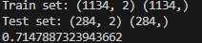
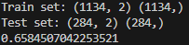
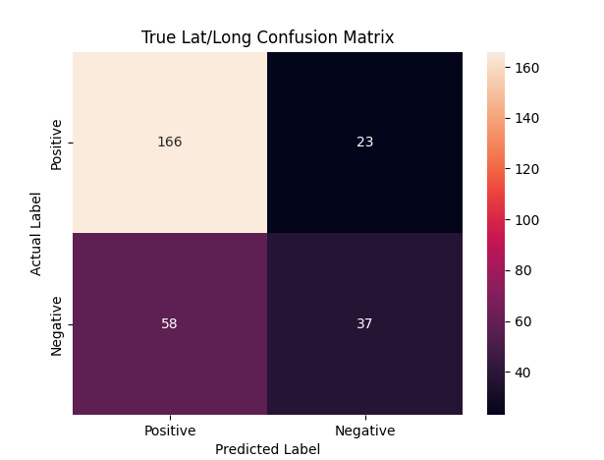
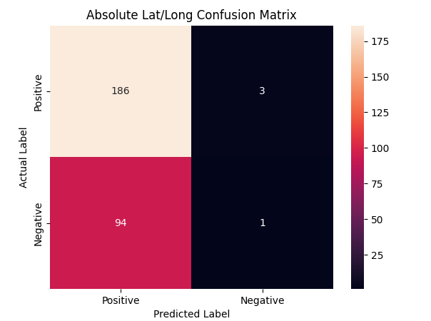
Landfall Regression & Confusion Matrix
Accuracy:

Slide 31
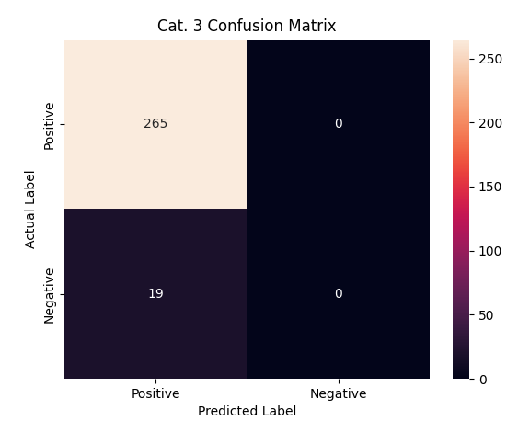
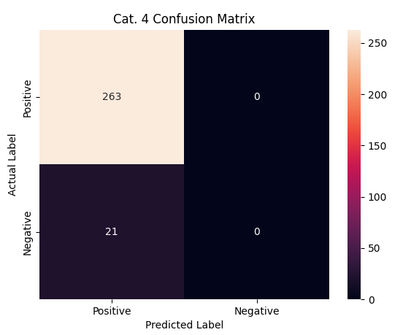
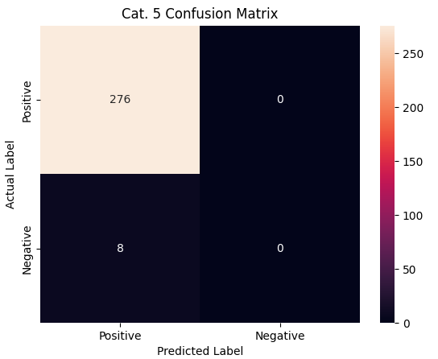
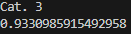
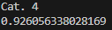
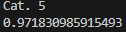
Storm category landfall by genesis coordinates
Category 3 vs. Landfall
Category 4 vs. Landfall
Category 5 vs. Landfall
Accuracy:
“Why are there no predicted negatives?”

Slide 32
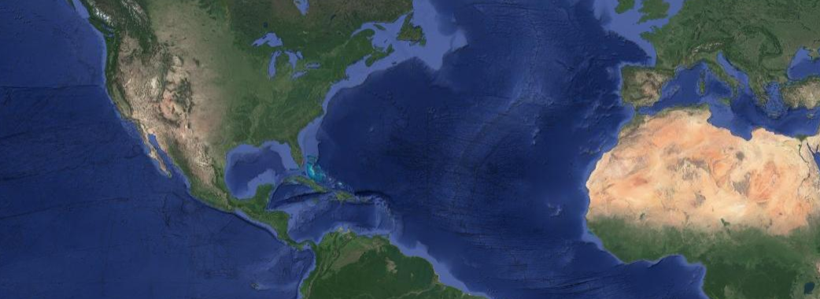
Which Measurement is best?
- “Higher accuracy?”
- “What is being measured?”
- “Numerical vs. categorical?”
20ºN
8ºN

Slide 33
Methodology
How was each visualization made?
STAT305 Step #4 - Google Collab Preview

Slide 34
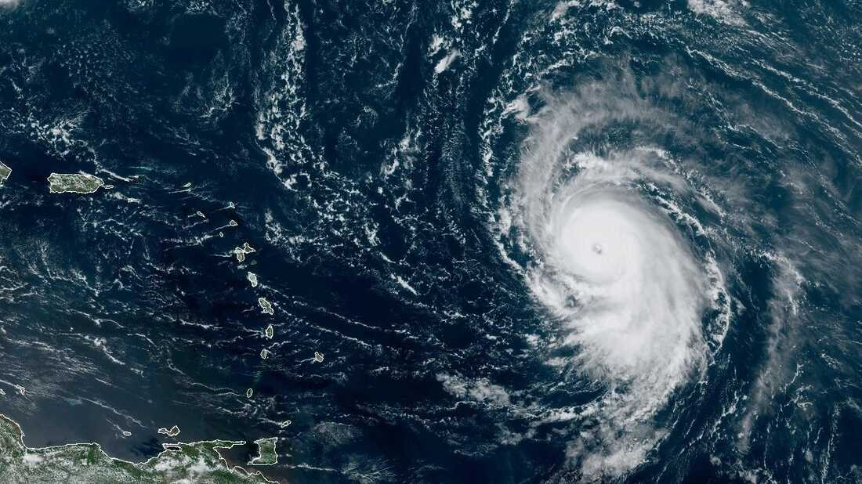
THANK YOU

